Slide 1
Data Base Users
Managing appointments for clients

Slide 2
The system was built to support the appointment service for customers and a business owner who wants to save time and personal conduct with his customers regarding appointments to him. The database is designed to contain all possible information on topics:
Introduction
Login details
Meeting data
All types of haircut
Data on book unavailability
View business days

Slide 3
The Entities
Users
Customers - The program designed for making appointmentsis at the barber shop without contacting the barber shop owner himself.
Barber - will receive his daily schedule without a personal answer to his customers.
Haircut (Name_of_haircut , Price)
CustomerUser (Id_user , Full_name , User_name , Pass_word )
Appointment (Id_of_appointment , Name_of_haircut** , t_id*, Id_user***) * References Time ** References Haircut *** References CustomerUser
Time (t_id ,year , month , day , hour , min)
blockedDays (year , month , day)
*

Slide 4
THE ERD
ID of appointment
T_ID
Name of hair cut
Id user
Appointments
1
n
1
has
has
1
has
1
Hair Cut
T_ID
1
Time
Name of hair cut
price
Costumers
month
hour
year
min
Pass word
User name
day
ID
Full name
month
year
day
Blocked Days

Slide 5
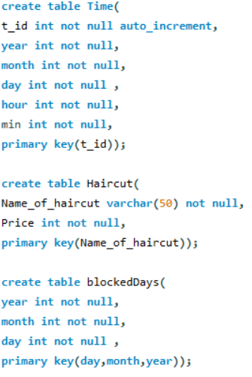
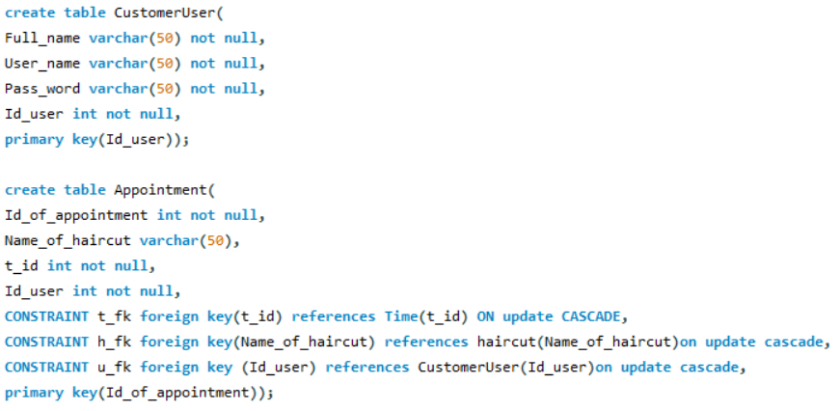
Create commands

Slide 6
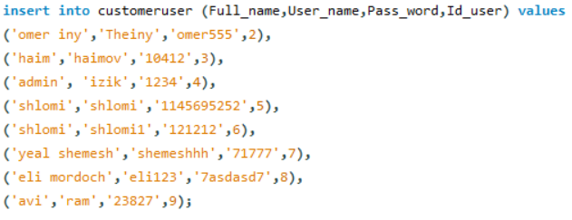

Some of the data

